Slide 1

The Solution: Oracle HCM CloudA complete system that delivers:
✔ Full automation of HR processes
✔ 98% payroll accuracy
✔ Streamlined recruitment
✔ Intelligent dashboards for decision-making

Slide 2
Direct Benefits for Your Organization
1. Time & Effort Savings
2. Error Reduction
3. Faster Hiring

Slide 3
Expected Financial Impact
✅ Annual Savings.
✅ Productivity improvement.
✅ ROI Period

Slide 4
Why Oracle ERP?
🔹 HR solution
🔹 Secure cloud infrastructure
🔹 24/7 technical support
🔹 Scalable with your company's growth

Slide 5
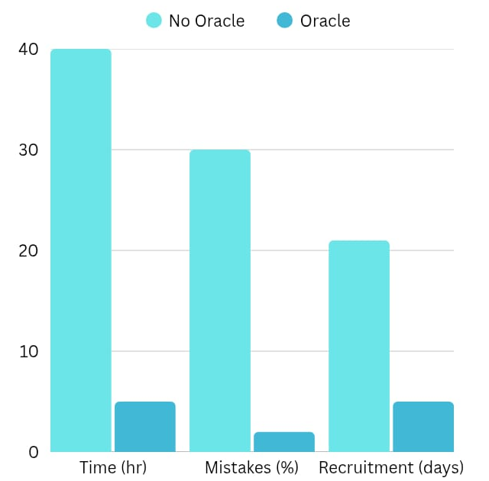
Investing in Oracle HCM is Investing in Your Company’s
Success

Slide 6



HOME
ABOUT
CONTENT
OTHERS
PAYROLL

Slide 7


ABOUT
Smarter way to handle payroll:-
How can payroll transform HR work?
Oracle Payroll is a smart, flexible system that automates salary management with full compliance.

Slide 8
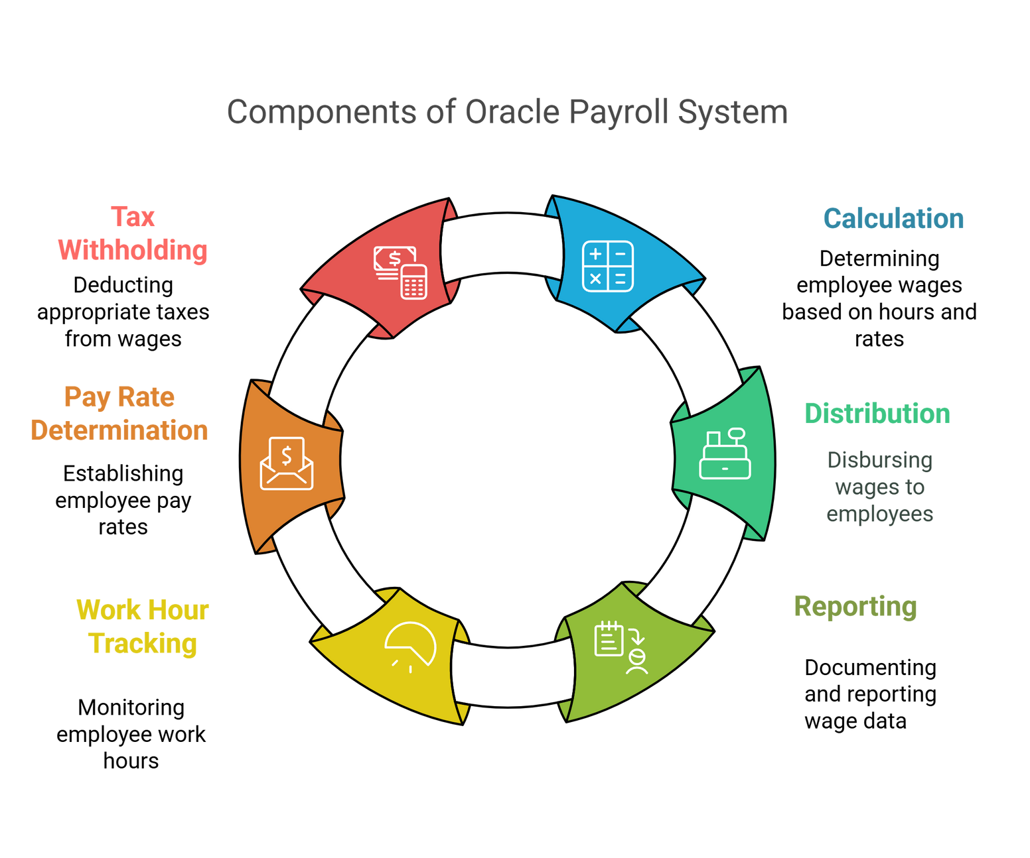
HOME
ABOUT
CONTENT
OTHERS
What is Payroll ?
oracle Payroll system is apart of oracle HCM enable efficient complaint and easy
Payroll
is the complete process of

Slide 9

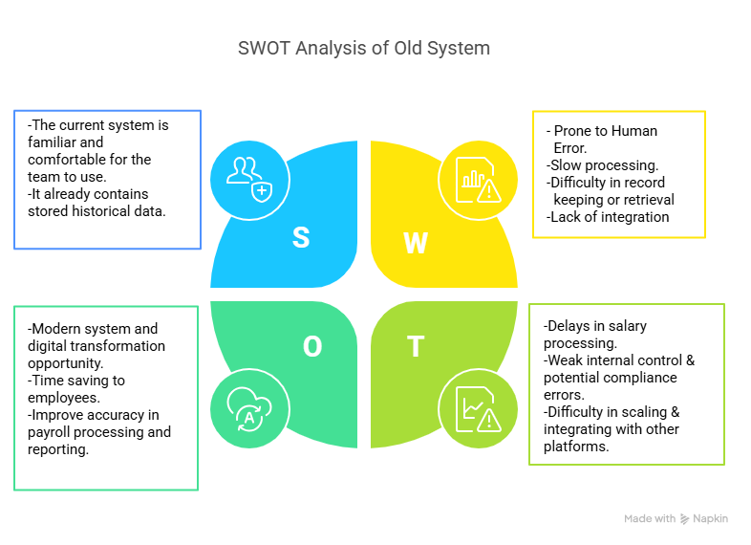
SWOT analysis
ABOUT

Slide 10
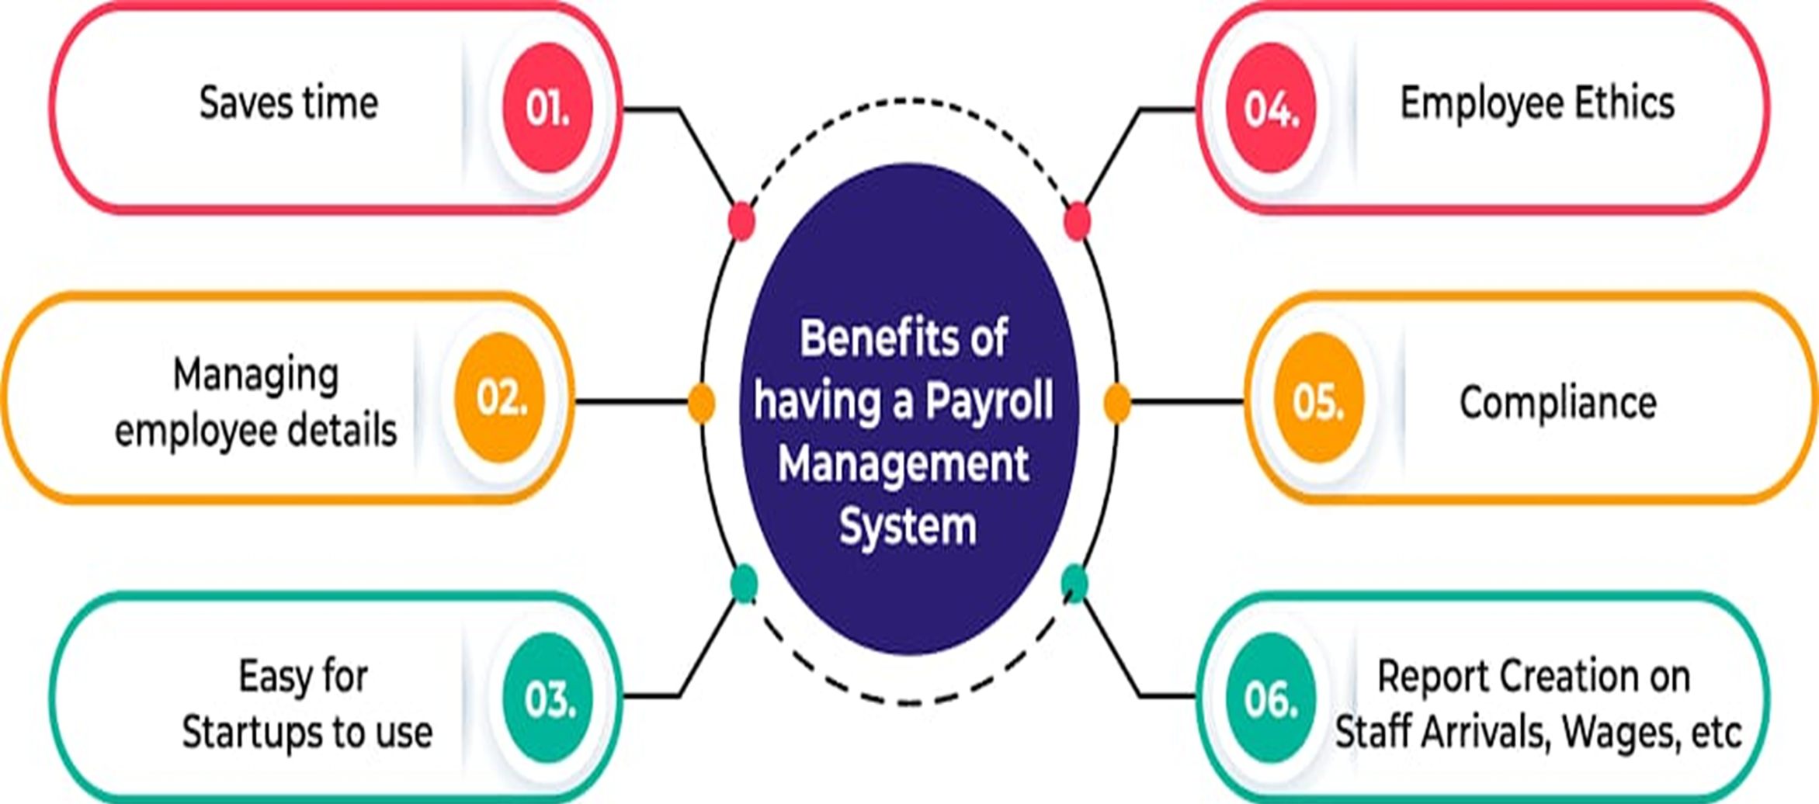

ABOUT
Why Oracle Payroll ?
Oracle payroll is corporates trustworthy as :-
Automated.
Compliance.
Security and data privacy.

Slide 11


Is flexible :-
Salary basis
Payroll elements
Define payment
Payment methods
FAST Formula & Quick pay

Slide 12
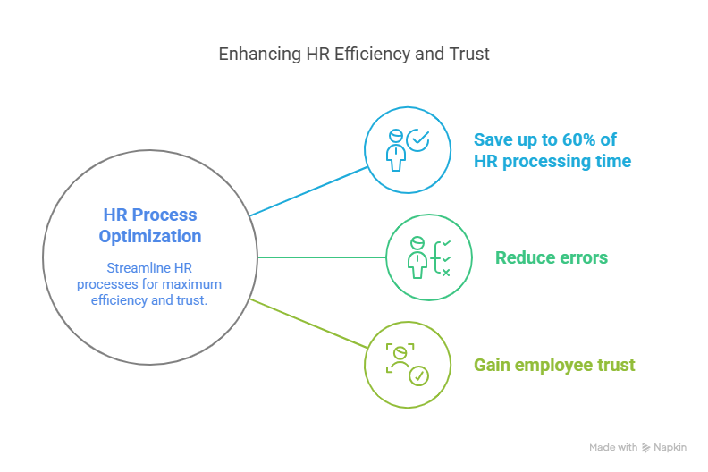
Let’s transform your business:-
ABOUT
Let’s take the next step together

Slide 13

ABOUT
Ready to start

Slide 14


Slide 15

Training Delivery
Training Evaluation
post-Training Support
Training Needs Analysis
Training Objectives
Training Plan

Slide 16


Slide 17
Why us ?
Customer satisfaction
Flexible pricing modele
Proven track record
Customer success team
Consultation
Customization
Customer support

Slide 18


DEMO

Slide 19
THANKS
https://demo.revo.sol
Phone : 01012345678
Email : revo.sol@gmail.com

